Slide 1

AW-SARIMA: A Nonstationary Time Series
Forecasting Framework via DWT and
Adaptive Thresholding
Peilin Liu, Zhiyu Zhou, Fangming Gu (Corresponding Author)
Luyang Zhang, Yixing Song, Sheng Lu
Jilin University, Changchun 130012, China
P. Liu
AW-SARIMA
July 2024
1 / 15

Slide 2


Research Background and Motivation
1
Limitations of Traditional Models
SARIMA and other models rely on linear assumptions, struggling to capture complex nonlinear relationships in real-world data
--Hastie, T et al.
2
Challenges in Deep Learning
Models like Time-LLM require large datasets and high computational resources, making them impractical for resource-constrained scenarios.
--Elsayed, S et al.
3
Nonstationary Series Characteristics
Real-world data contains superimposed trends, cycles, and noise,
where traditional denoising methods lack adaptability.
4
Research Significance
Providing an efficient forecasting solution for low-latency,
small-sample scenarios with limited computational resources?
P. Liu
AW-SARIMA
July 2024
2 / 15

Slide 3

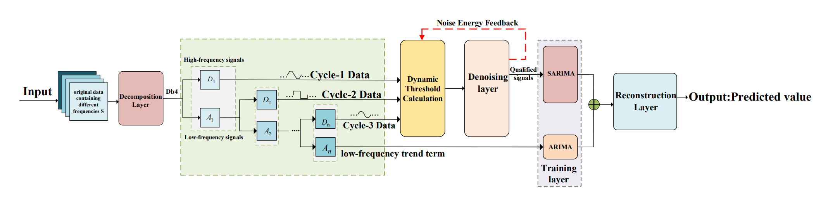
Our Research Objectives
1
Prediction Accuracy
2
Noise Robustness
How? Improve prediction accuracy for nonstationary time series through
How ?Enhance model robustness against noisy data using dynamic threshold
adaptive decomposition and denoising techniques.
mechanisms and energy feedback.
3
Computational Efficiency
4
Cross-domain Generalization
How? Maintain low computational complexity for resource-constrained
How? Achieve cross-domain generalization capability through adaptive
environments while achieving competitive performance.
mechanisms that adjust to different data characteristics.
P. Liu
AW-SARIMA
July 2024
3 / 15

Slide 4
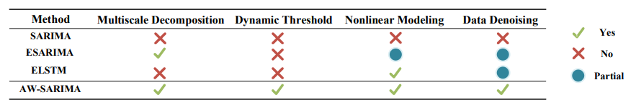
Related Work Comparison
Model
Representative Methods
Limitation
Limitations
Traditional Statistical
SARIMA
Lightweight, strong interpretability
Limited by linear assumptions, poor noise
Models
resistance
Deep Learning Models
Time-LLM
Strong capability in capturing complex
High data requirements, large computational
patterns
cost
Hybrid Models
EARIMA
Combines DWT with traditional
Static threshold leads to poor cross-domain
models
generalization
P. Liu
AW-SARIMA
July 2024
4 / 15

Slide 5
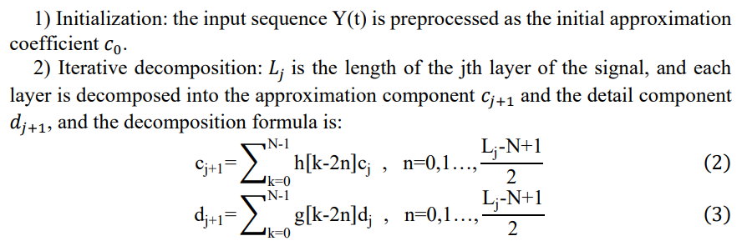
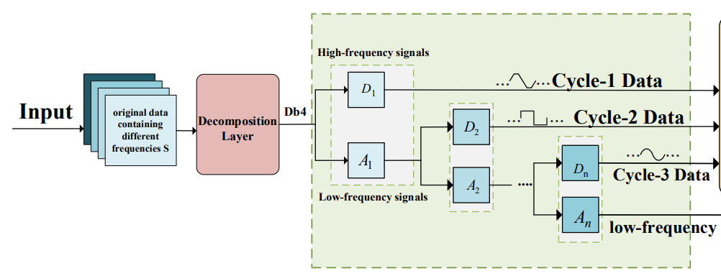
Our Methodology: DWT Signal Decomposition
Discrete Wavelet Transform (DWT)
Mallat Fast Algorithm
Multi-scale decomposition of original signals into distinct frequency bands:
Low-frequency components: Capture trend and periodic information
High-frequency components: Contain noise and mutation information
Decomposition Process
Original time series → Approximate component (A) + Detail components (D)
Original
A (Trend)
D1 (High Freq)
D2 (Med Freq)
P. Liu
AW-SARIMA
July 2024
5 / 15

Slide 6
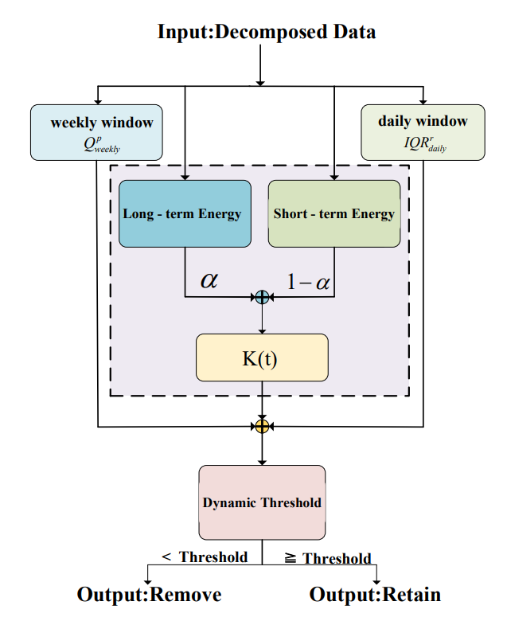
Our Methodology: Adaptive Dynamic Threshold Design
1
Threshold Calculation Mechanism
Combines historical baseline and real-time adjustment:
Weekly quantile statistics + Daily window IQR (Interquartile Range)
2
Energy Feedback Mechanism
Real-time monitoring of noise energy
to dynamically adjust thresholds:
Threshold Function
3
Piecewise nonlinear function balancing
4
Key Benefits
1、Reduces misjudgment in low-noise regions
2、Minimizes residual interference in high-noise regions
3、Enhances cross-domain generalization
P. Liu
AW-SARIMA
July 2024
6 / 15

Slide 7


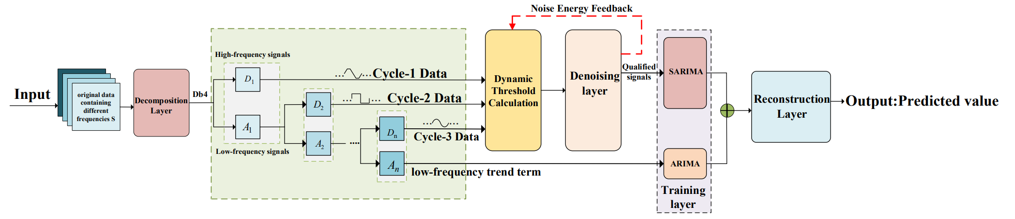
AW-SARIMA Overall Framework
1
Signal Decomposition
2
Adaptive Denoising
DWT multi-scale decomposition of original time series into distinct
Dynamic threshold processing of each frequency component based on
frequency components.
noise energy feedback.
3
Component Forecasting
4
Signal Reconstruction
SARIMA models predict denoised components separately with
Fusion of multi-band prediction results using inverse DWT to generate
optimized parameters.
final forecast.
P. Liu
AW-SARIMA
July 2024
7 / 15

Slide 8

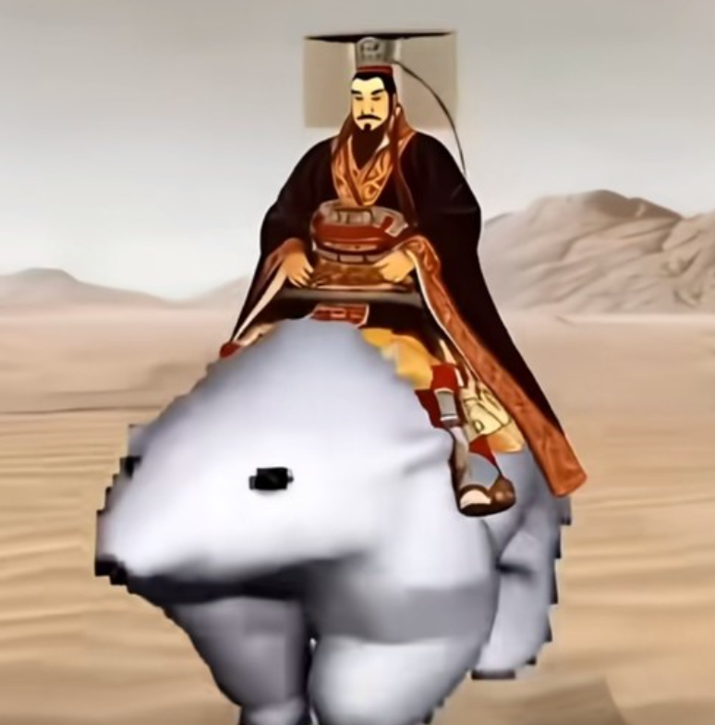


Experimental Datasets
1
Transportation
2
Healthcare
3
Power Systems
Dataset: ATL Airport Passenger Flow
Dataset: NCDC Nigerian Cholera Cases
Dataset: ETTh1 Electricity Load
Characteristics: Strong seasonality,
Characteristics: Irregular outbreaks,
Characteristics: Periodic patterns,
holiday peaks
sparse data
demand spikes
Samples: 1,500 data points
Samples: 800 data points
Samples: 2,000 data points
P. Liu
AW-SARIMA
July 2024
8 / 15

Slide 9
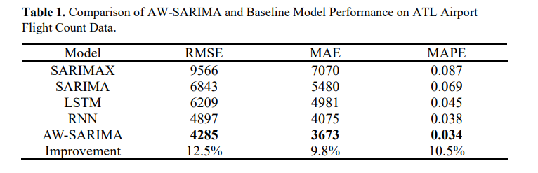
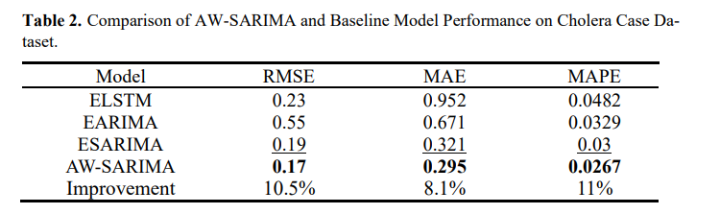
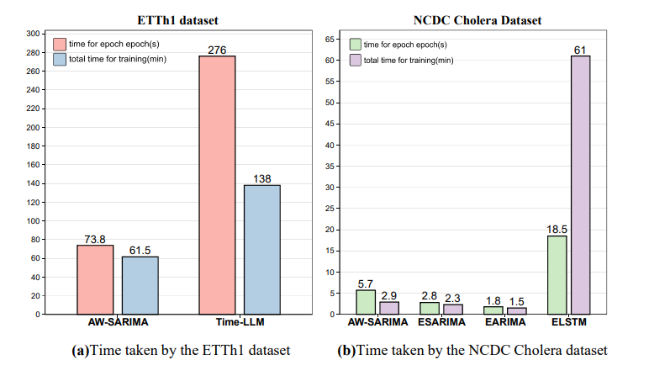
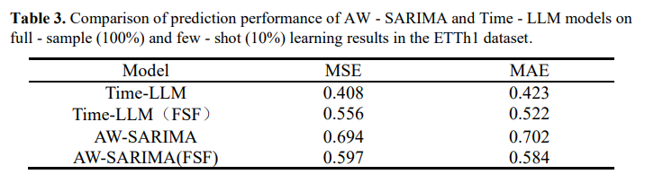
Key Experimental Results
P. Liu
AW-SARIMA
July 2024
10 / 15

Slide 10
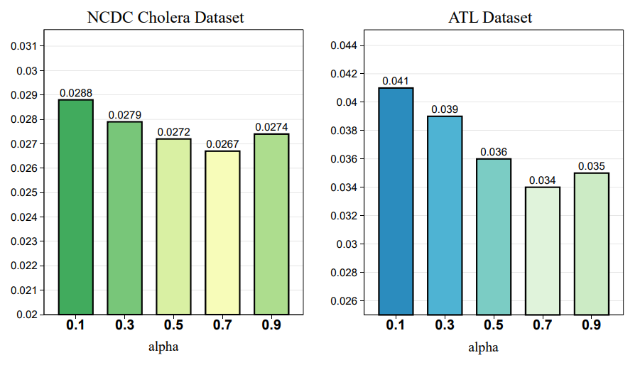
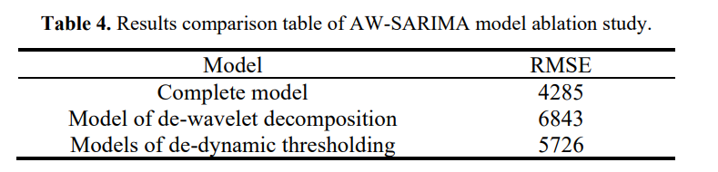
Ablation Study: Component Contribution Analysis
Performance Change
Table 4 presents the results of the ablation study for the AW - SARIMA model, where RMSE values are compared across different model variants. The complete AW - SARIMA model achieves an RMSE of 4285. When the wavelet decomposition module is removed (Model of de - wavelet decomposition), the RMSE deteriorates to 6843. Removing the dynamic thresholding module (Models of de - dynamic thresholding) also leads to a higher RMSE of 5726, indicating the importance of these components in minimizing prediction errors.
Additionally, the two bar charts on the right illustrate the sensitivity analysis results. For the NCDC Cholera Dataset and ATL Dataset, the RMSE values vary with different alpha values. This sensitivity analysis helps to understand how the model performance is impacted by adjusting the alpha parameter, providing insights into the model's robustness and the optimal parameter settings for different datasets.
P. Liu
AW-SARIMA
July 2024
11 / 15

Slide 11

Future Work
Methodological Improvements
Application Extensions
Theoretical Research
✓
Multi-wavelet basis fusion strategy
✓
Optimization for real-time streaming
✓
Mathematical convergence proof
✓
Introduction of attention mechanism
data
✓
Stability analysis of threshold
✓
Enhanced key feature weighting
✓
Expansion to multivariate time series
adjustment
✓
Edge computing deployment
✓
Generalization error bounds
-- You gotta have a dream—who knows? It might just pull a "surprise attack" and come true one day.
P. Liu
AW-SARIMA
July 2024
14 / 15

Slide 12

The End
Core Contributions:
1. Proposed DWT-assisted lightweight hybrid framework
2. Designed adaptive dynamic threshold mechanism to improve generalization
3. Achieved cross-domain efficient prediction with significantly reduced
computational cost
Thank you all for your attention
Hope y’all get ideas popping up like magic, and your papers get accepted right after submission!
P.
AW-
July
15
Liu
SARIMA
/
15

Slide 13
Q&A
Welcome questions and discussions

